Slide 1

Note: The data and information in this document is reflective of a hypothetical situation and client. This document is to be used for KPMG Virtual Internship purposes only.
Sprocket Central Pty Ltd
Data analytics approach

Slide 2
Note: The data and information in this document is reflective of a hypothetical situation and client. This document is to be used for KPMG Virtual Internship purposes only.
Agenda
Introduction
Data Exploration
Model Development
Interpretation

Slide 3
Note: The data and information in this document is reflective of a hypothetical situation and client. This document is to be used for KPMG Virtual Internship purposes only.
Introduction
The strategies to be applied to gain the insights about the potential customers are discussed in this presentation. Few of them are:
Gender distribution
Past 3 years history of bike purchase
Job industry category
Wealth segment
People who owns car already

Slide 4
Note: The data and information in this document is reflective of a hypothetical situation and client. This document is to be used for KPMG Virtual Internship purposes only.
Data Exploration
This shows the process of feature engineering where the meaningful features are selected for developing insights.
The insights while exploring the data shows that the past 3 years bike purchase history, gender distribution, wealth segment, job industry category, already owns car are the features selected for developing the insights of the potential customers.

Slide 5
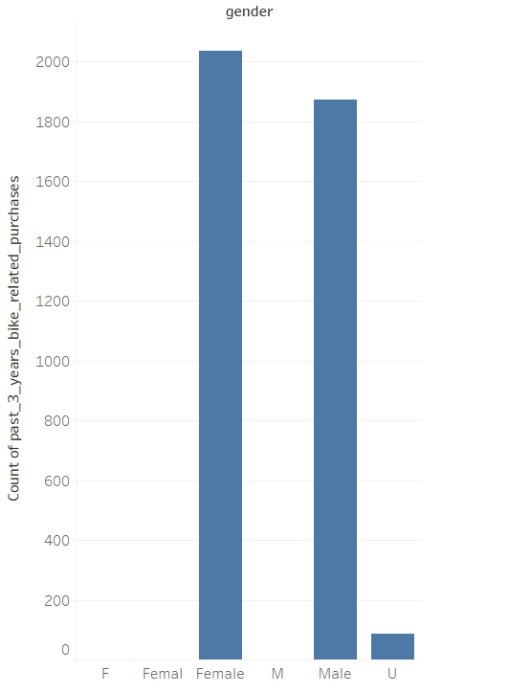
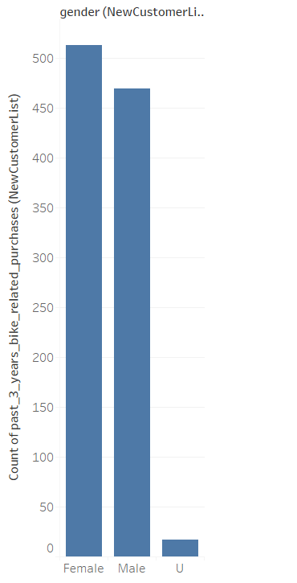
Note: The data and information in this document is reflective of a hypothetical situation and client. This document is to be used for KPMG Virtual Internship purposes only.
Data Exploration
Gender distribution of old customers vs new customers
-- Old customers
--New customers

Slide 6
Note: The data and information in this document is reflective of a hypothetical situation and client. This document is to be used for KPMG Virtual Internship purposes only.
Data Exploration
Insights:
The insights from the gender distribution against the past 3 years history of bike purchase shows that the female customers are more in both the new customers and the old customers.
So it is clear that the female customers are much potential one and should be focused on to increase our revenue.
Also, the male customers are nearer to the female customer’s purchase history, so it’s not wise to not consider the male customers.

Slide 7
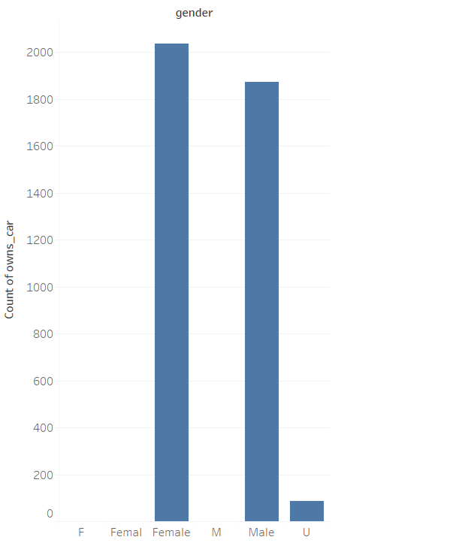
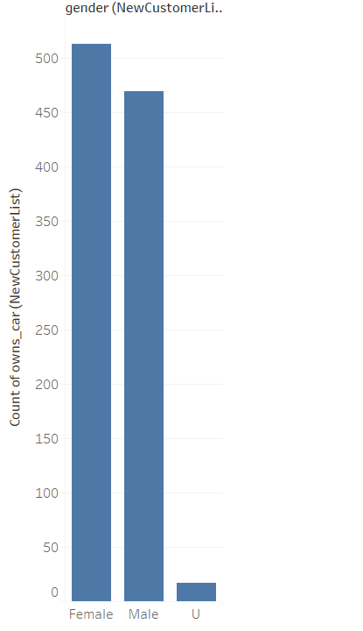
Note: The data and information in this document is reflective of a hypothetical situation and client. This document is to be used for KPMG Virtual Internship purposes only.
Model Development
People who already owns car
With the plots and the insights, it’s clear
that the female customers tend to own car already and so they would be considered as the potential customers.
Also, the male customers tend to own
cars above 450 which is closer to female customers whose count is above 500 in new customers and 1800+ in old customers list which is near to female customers whose count is 2000+ in old customers.
Hence, next to female customers, male
customers could also seem to be the potential customers we seek.
New Customers
Old customers

Slide 8
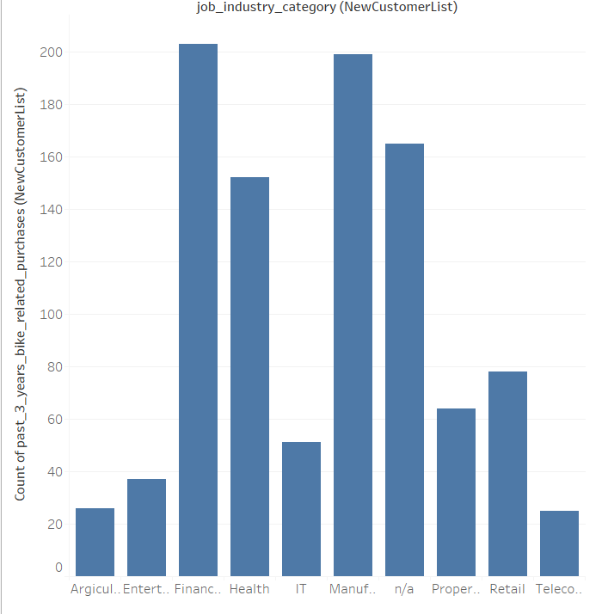
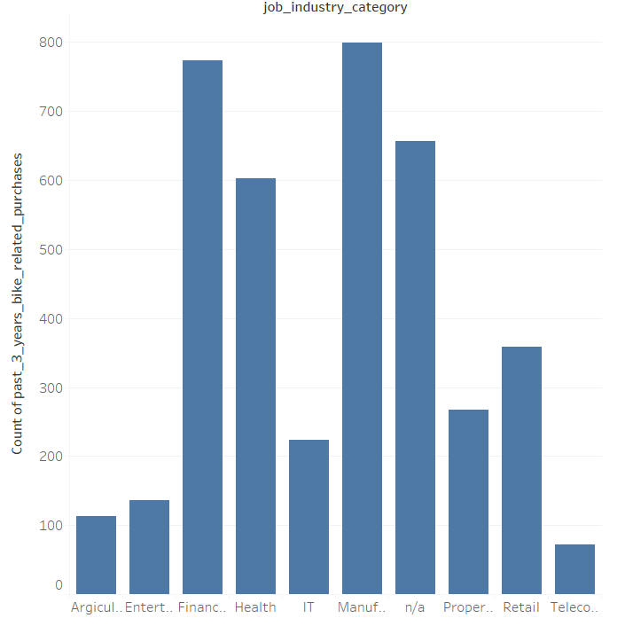
Note: The data and information in this document is reflective of a hypothetical situation and client. This document is to be used for KPMG Virtual Internship purposes only.
Model Development
Job industry category vs past 3 years purchase history
New Customers
Old customers
From the insights, it is clear that the Financial Services sector and Manufacturing industry shows the highest count of purchase history.
Hence, these two sector people should be considered the most as the potential customers.
Also, people under health industry seems to purchase cars whose count is near to the Manufacturing sector. Hence, these people also should be considered as the potential customers.

Slide 9
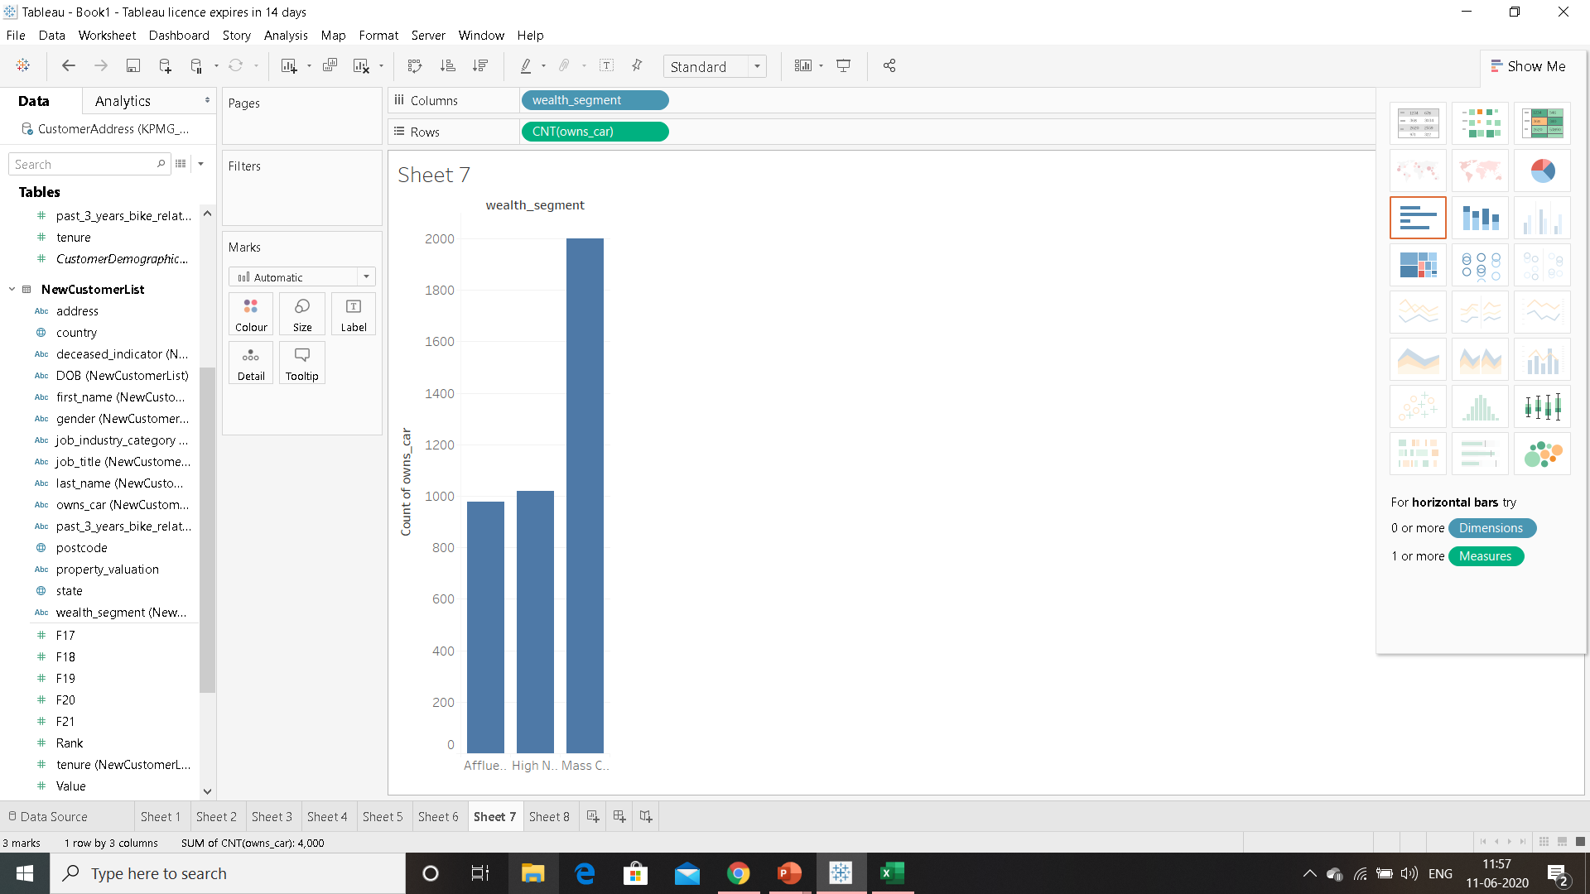

Note: The data and information in this document is reflective of a hypothetical situation and client. This document is to be used for KPMG Virtual Internship purposes only.
Interpretation
Wealth segment against owns_car already field
Old customers
New Customers

Slide 10


Note: The data and information in this document is reflective of a hypothetical situation and client. This document is to be used for KPMG Virtual Internship purposes only.
Interpretation
Wealth segment against purchase history of past 3 years
Old customers
New Customers

Slide 11
Note: The data and information in this document is reflective of a hypothetical situation and client. This document is to be used for KPMG Virtual Internship purposes only.
Interpretation
Insights:
From the visuals and plots, considering both the old customers and new customers, mass customers category has the highest count of people who already owns the car.
So, it is necessary to see the people belonging to this category as the potential customer and increase the sales and its revenue.
Similarly, the people in the Mass Customers category has the highest purchase history in the past 3 years.
So, it is now clear that the Mass Customers are our potential target customers.
For secondary conditions, people in the high net worth category seems to be averagely owning the car and also has a medium count of purchase history in the past three years. So, these people may also be considered as the customers we seek.

Slide 12
Note: The data and information in this document is reflective of a hypothetical situation and client. This document is to be used for KPMG Virtual Internship purposes only.
Conclusion
Hence, the provided dataset is analysed precisely, features that could improve the sales are identified and the visualizations are developed using which the potential customers can be seeked correctly.
Thank you,
With Regards,
Srividhya R

